Slide 1
Importance of (Low) Inertial Effective Mass as Transport Descriptor in Data-driven Thermoelectric Screening
Abstract
In this work we provide a data-driven analysis on the role of effective mass and its related descriptors i.e. fermi surface complexity factor in high-throughput thermoelectric materials screening. Leveraging on the available datasets and data from Materials Project, we reveal the crucial role of effective mass on electronic transport. We propose that in low inertial effective mass materials, any changes in crystal symmetry, band alignment, or doping have a pronounced effect on enhancing the material’s thermoelectric power factor

Slide 2

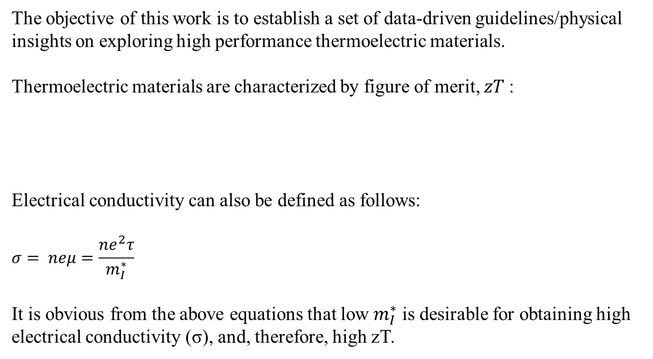

Background and methodology
The objective of this work is to establish a set of data-driven guidelines/physical insights on exploring high performance thermoelectric materials.
Thermoelectric materials are characterized by figure of merit, $zT$:
Electrical conductivity can also be defined as follows:
$$σ= neμ=\frac{ne^{2}τ}{m_{I}^{∗}}$$
It is obvious from the above equations that low $m_{I}^{∗}$ is desirable for obtaining high electrical conductivity (σ), and, therefore, high zT.
$$zT=\frac{S^{2}σT}{\text{κ}}$$
where S is Seebeck coefficient, σ is electrical conductivity, T is absolute temperature and κ is thermal conductivity
where $m_{I}^{∗}$ represents inertial effective mass.

Slide 3
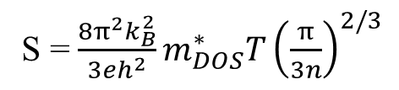
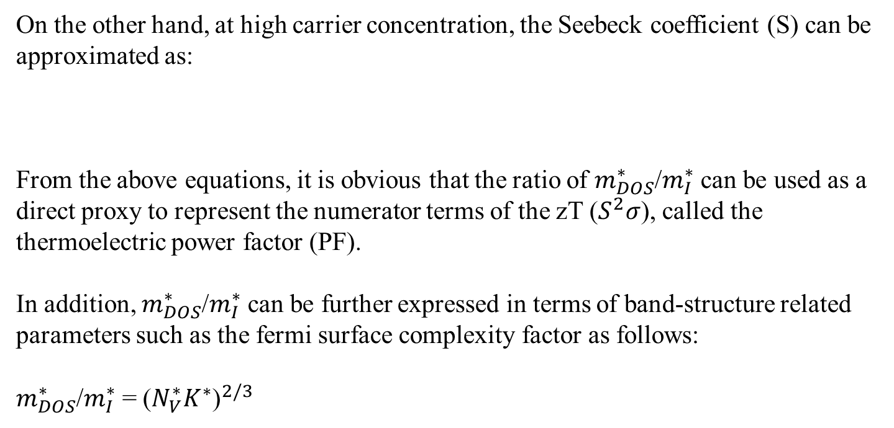
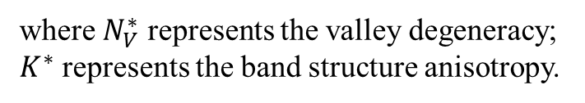
Background and methodology
On the other hand, at high carrier concentration, the Seebeck coefficient (S) can be approximated as:
From the above equations, it is obvious that the ratio of $m_{DOS}^{∗}$/$m_{I}^{∗}$ can be used as a direct proxy to represent the numerator terms of the zT ($S^{2}σ$), called the thermoelectric power factor (PF).
In addition, $m_{DOS}^{∗}$/$m_{I}^{∗}$ can be further expressed in terms of band-structure related parameters such as the fermi surface complexity factor as follows:
$m_{DOS}^{∗}$/$m_{I}^{∗}$ =${ \text{(}N_{V}^{∗}K^{∗}\text{)}}^{2/3}$
S = $\frac{8π^{2}k_{B}^{2}}{3eh^{2}}m_{DOS}^{∗}T{\left(\frac{π}{3n}\right)}^{2/3}$
where $m_{DOS}^{∗}$ represents the density of states effective mass.
where $N_{V}^{∗}$ represents the valley degeneracy;
$K^{∗}$ represents the band structure anisotropy.

Slide 4
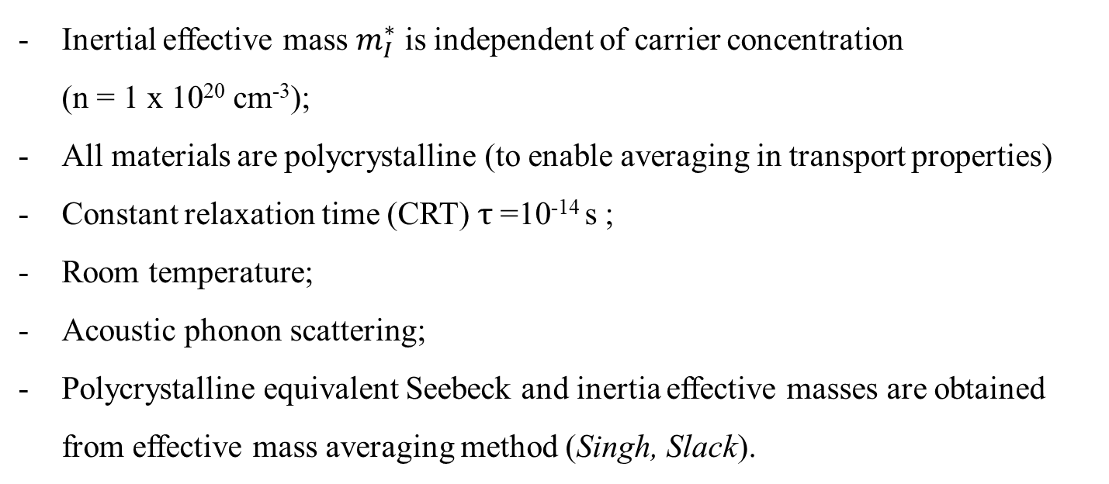
Assumptions
Inertial effective mass $m_{I}^{∗}$ is independent of carrier concentration (n = 1 x 10²⁰ cm⁻³);
All materials are polycrystalline (to enable averaging in transport properties)
Constant relaxation time (CRT) $τ$=10⁻¹⁴ s ;
Room temperature;
Acoustic phonon scattering;
Polycrystalline equivalent Seebeck and inertia effective masses are obtained from effective mass averaging method (Singh, Slack).

Slide 5
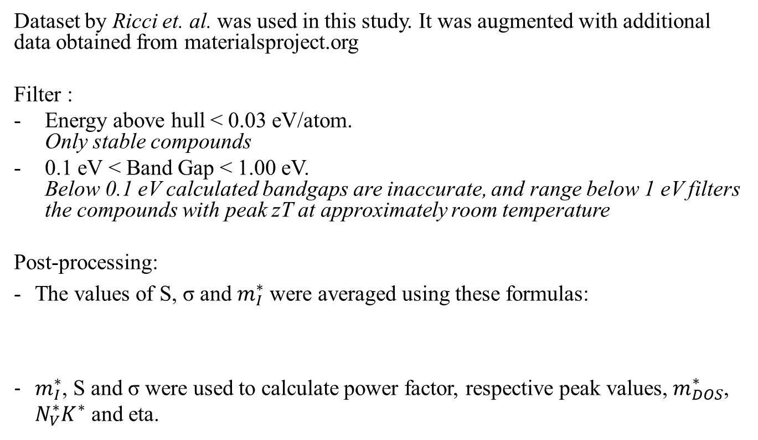
Dataset
Dataset by Ricci et. al. was used in this study. It was augmented with additional data obtained from materialsproject.org
Filter :
Energy above hull < 0.03 eV/atom. Only stable compounds
0.1 eV < Band Gap < 1.00 eV. Below 0.1 eV calculated bandgaps are inaccurate, and range below 1 eV filters the compounds with peak zT at approximately room temperature
Post-processing:
The values of S, σ and $m_{I}^{∗}$ were averaged using these formulas:
$m_{I}^{∗}$, S and σ were used to calculate power factor, respective peak values, $m_{DOS}^{∗}$, $N_{V}^{∗}K^{∗}$ and eta.
$S_{eff}= \sqrt{SxxSyySzz}$, $σ=\frac{σ_{xx}+σ_{yy}+σ_{zz}}{3}$, and $m_{I}^{∗}$ = ${3\left(\frac{1}{mxx}+\frac{1}{myy}+\frac{1}{mxx}\right)}^{−1}$

Slide 6
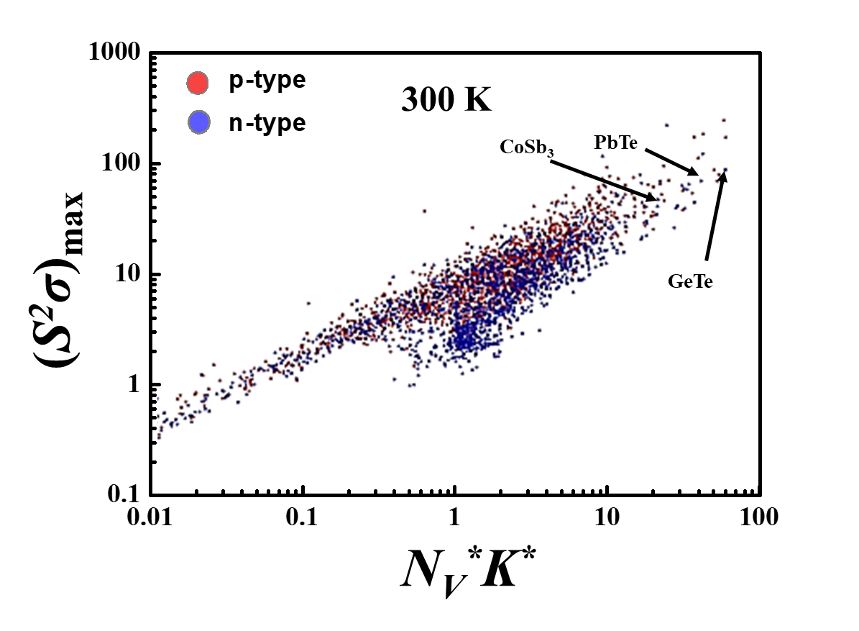
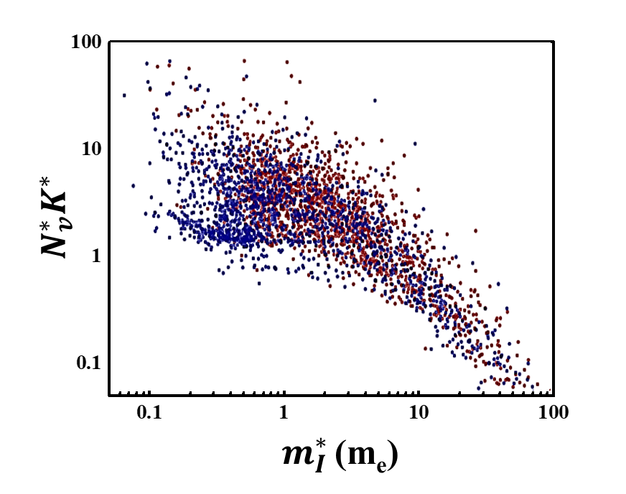
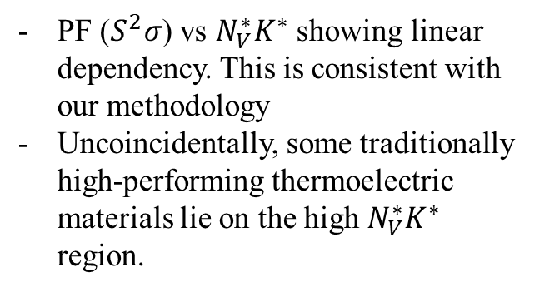
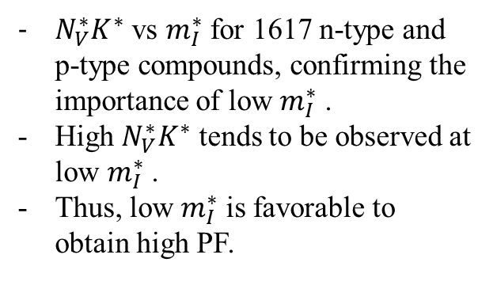
Analysis and Results
Fig 1
Fig 2
PF ($S^{2}σ$) vs $N_{V}^{∗}K^{∗}$ showing linear dependency. This is consistent with our methodology
Uncoincidentally, some traditionally high-performing thermoelectric materials lie on the high $N_{V}^{∗}K^{∗}$ region.
$N_{V}^{∗}K^{∗}$ vs $m_{I}^{∗}$ for 1617 n-type and p-type compounds, confirming the importance of low $m_{I}^{∗}$ .
High $N_{V}^{∗}K^{∗}$ tends to be observed at low $m_{I}^{∗}$ .
Thus, low $m_{I}^{∗}$ is favorable to obtain high PF.

Slide 7
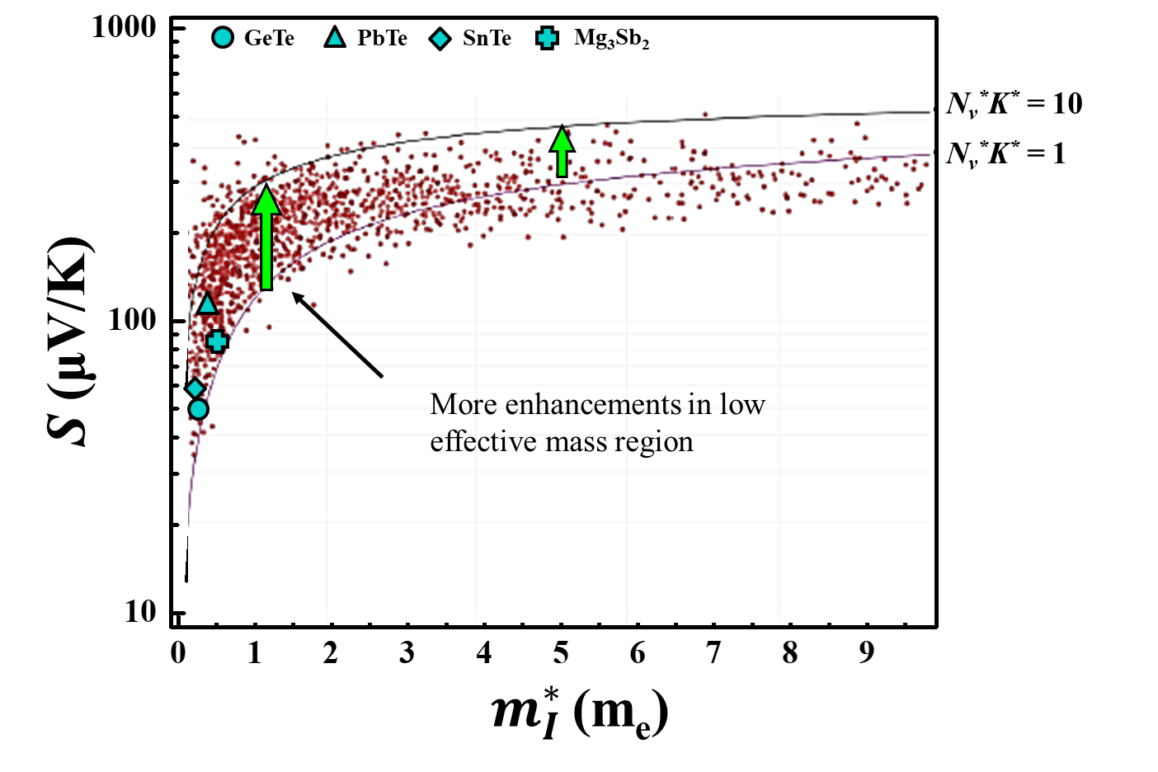
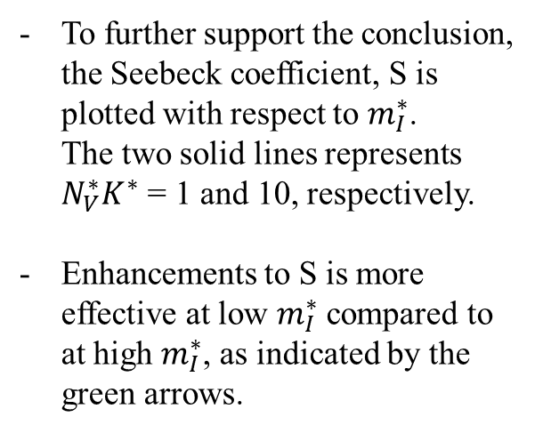
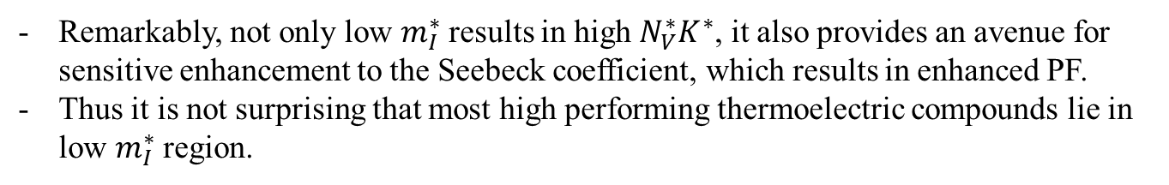
Analysis and Results
To further support the conclusion, the Seebeck coefficient, S is plotted with respect to $m_{I}^{∗}$. The two solid lines represents $N_{V}^{∗}K^{∗}$ = 1 and 10, respectively.
Enhancements to S is more effective at low $m_{I}^{∗}$ compared to at high $m_{I}^{∗}$, as indicated by the green arrows.
Fig 3
Remarkably, not only low $m_{I}^{∗}$ results in high $N_{V}^{∗}K^{∗}$, it also provides an avenue for sensitive enhancement to the Seebeck coefficient, which results in enhanced PF.
Thus it is not surprising that most high performing thermoelectric compounds lie in low $m_{I}^{∗}$ region.

Slide 8
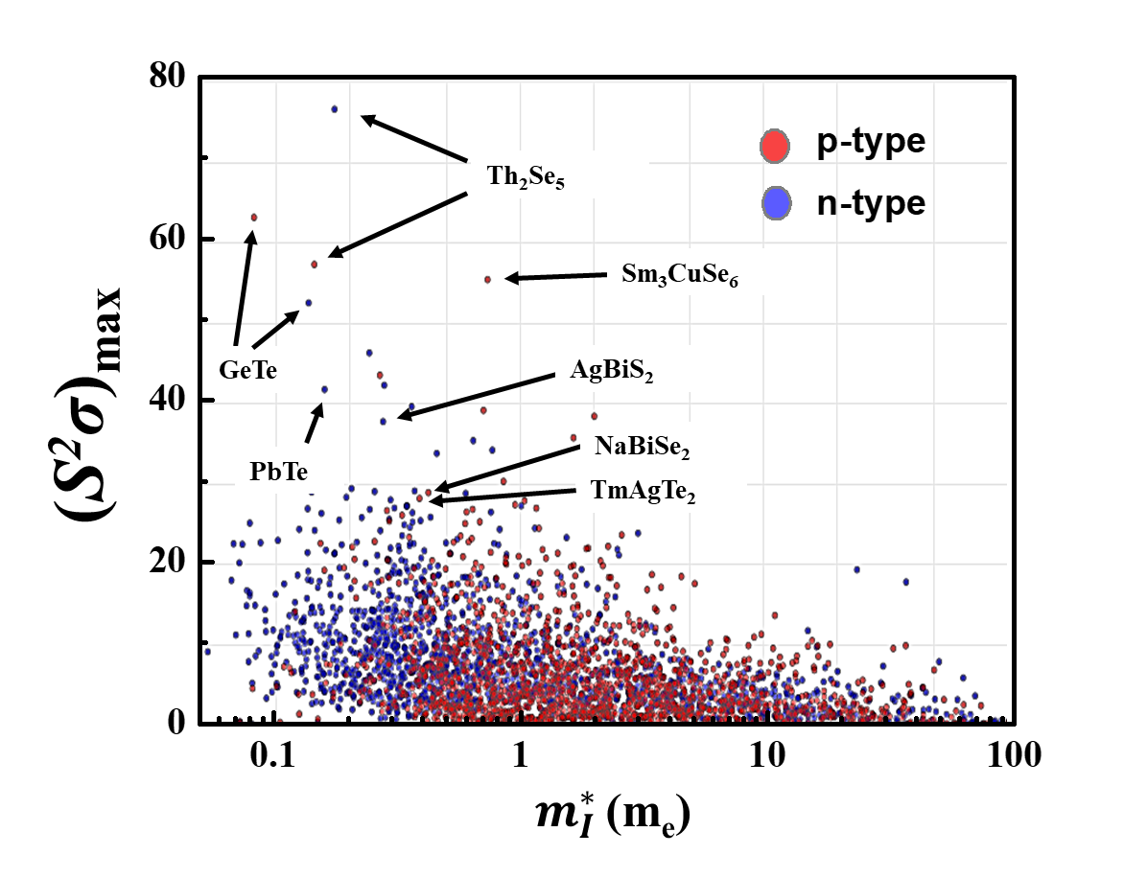
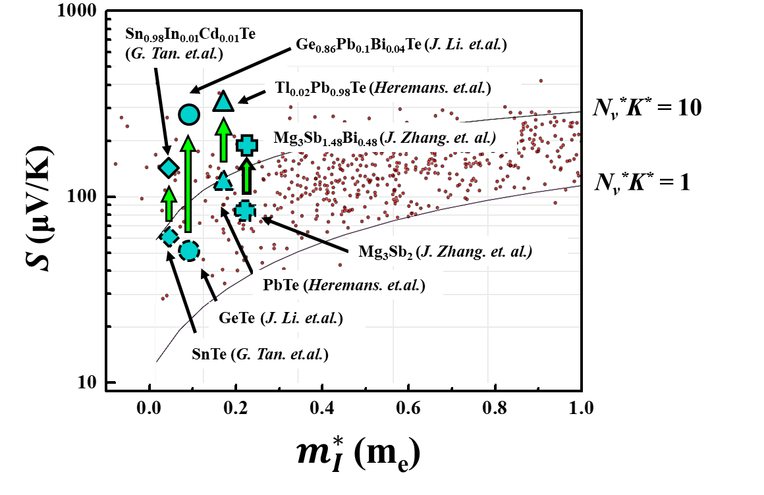
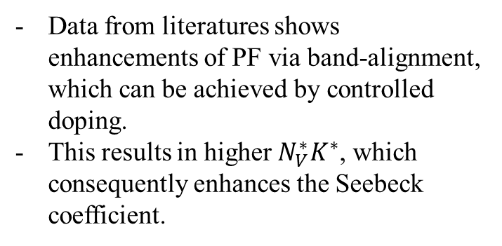
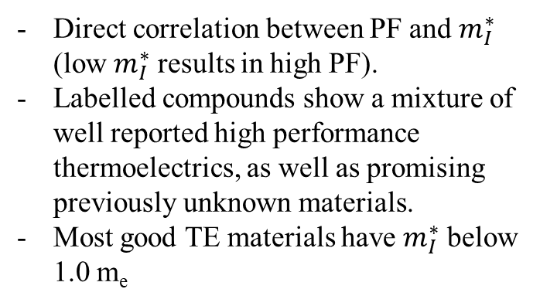
Analysis and Results
Fig 4
Fig 5
Data from literatures shows enhancements of PF via band-alignment, which can be achieved by controlled doping.
This results in higher $N_{V}^{∗}K^{∗}$, which consequently enhances the Seebeck coefficient.
Direct correlation between PF and $m_{I}^{∗}$ (low $m_{I}^{∗}$ results in high PF).
Labelled compounds show a mixture of well reported high performance thermoelectrics, as well as promising previously unknown materials.
Most good TE materials have $m_{I}^{∗}$ below 1.0 m_{e}

Slide 9
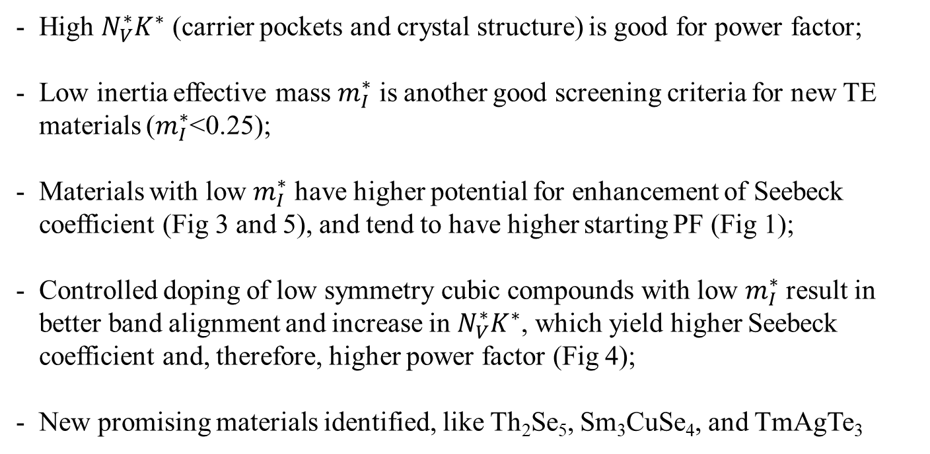
Conclusion
High $N_{V}^{∗}K^{∗}$ (carrier pockets and crystal structure) is good for power factor;
Low inertia effective mass $m_{I}^{∗}$ is another good screening criteria for new TE materials ($m_{I}^{∗}$<0.25);
Materials with low $m_{I}^{∗}$ have higher potential for enhancement of Seebeck coefficient (Fig 3 and 5), and tend to have higher starting PF (Fig 1);
Controlled doping of low symmetry cubic compounds with low $m_{I}^{∗}$ result in better band alignment and increase in $N_{V}^{∗}K^{∗}$, which yield higher Seebeck coefficient and, therefore, higher power factor (Fig 4);
New promising materials identified, like Th₂Se₅, Sm₃CuSe₄, and TmAgTe₃

Slide 10
References
J. Yan et al., Material descriptors for predicting thermoelectric performance. Energy & Environmental Science 8, 983-994 (2015).
Z. M. Gibbs et al., Effective mass and Fermi surface complexity factor from ab initio band structure calculations. npj Computational Materials 3, 8 (2017).
F. Ricci et al., An ab initio electronic transport database for inorganic materials. Scientific data 4, 170085 (2017).
W. Chen et al., Understanding thermoelectric properties from high-throughput calculations: trends, insights, and comparisons with experiment. Journal of Materials Chemistry C 4, 4414-4426 (2016).
D. S. Parker, A. F. May, D. J. Singh, Benefits of carrier-pocket anisotropy to thermoelectric performance: The case of p-type AgBiSe₂. Physical Review Applied 3, 064003 (2015).
J. P. Heremans et al., Enhancement of thermoelectric efficiency in PbTe by distortion of the electronic density of states. Science 321, 554-557 (2008).
Q. Zhang et al., High thermoelectric performance by resonant dopant indium in nanostructured SnTe. Proceedings of the National Academy of Sciences 110, 13261-13266 (2013).
Y. Takagiwa, Y. Pei, G. Pomrehn, G. Snyder, Dopants effect on the band structure of PbTe thermoelectric material. Applied Physics Letters 101, 092102 (2012).
C. M. Jaworski, V. Kulbachinskii, J. P. Heremans, Resonant level formed by tin in Bi 2 Te 3 and the enhancement of room-temperature thermoelectric power. Physical Review B 80, 233201 (2009).
M. D. Nielsen, V. Ozolins, J. P. Heremans, Lone pair electrons minimize lattice thermal conductivity. Energy & Environmental Science 6, 570-578 (2013).

